Slide 1
Chapter 7
The Age of Jefferson

Slide 2
Efforts for Change
Jeffersonian Republicans wanted change from European cultures.
  Educational, Cultural, Ideological, Economical
  Strove to create society where agrarian society held as much control as bureaucrats

Slide 3
Advancement under Jefferson
Education
  Proposed free education for electors so they could cast educated votes
  Educate women so they could raise an educated nation
  Number of Universities tripled for higher education
Medicine
  Pennsylvania University first Medical school
  Move from midwives to doctor deliveries
  Medical process still relatively slow due to stiff resistance to traditional beliefs

Slide 4
An American Culture Develops
Noah Webster
  Devised first American spelling book with changes to the English language to distinguish from Britain.
Washington Irving
  Developed fable stories regarding the new world that reflected satirical beliefs of America
    Included Rip Van Winkle and Ichabod Crane.
Historical texts were developed with the intent of glorifying American accomplishments.
  Mason Weems, Life of Washington told fictitious story about the cherry tree.

Slide 5
American Culture Cont.
Religion
  Deism: belief that a god exists, but after creation withdrew from direct involvement with the universe.
  Jefferson and Franklin were both deist believers
  More enlightened, scientific, and objective views on religion began to question the authority of the church.
Jefferson’s letter to Connecticut legislature reflects his ideas of separation of church and state.

Slide 6
Religion Cont.
Second Great Awakening
  Emergence of the Methodist, Presbyterian, and Baptist Churches in America (all begun in Europe)
  Revivals spread throughout the country, popular evangelists had followers that traveled with them.
  Cane Ridge: Kentucky town with largest revival recorded
    Estimated 25,000 people in attendance for single revival.
Impact of Second Great Awakening helped to solidify the identity of new towns and territories developing nationwide, created sensed of unity.

Slide 7
Industry and Technology
Some inventions and innovations resulted from immigration from Europe
  Samuel Slater’s Spinning Mill in Pawtucket, Rhode Island became the first modern factory in America.
Oliver Evan’s automated flour mill was a genuine American invention that changed wheat industry.
Outbreak of war in Europe enabled American ships to become primary source for transportation of goods across the Atlantic.
  Urged forward emphasis on large ship building economy in America.

Slide 8
Innovations Cont.
Invention of the Steam Boat: used for interstate commerce along river systems.
  Many early inventors such as Oliver Evans, John Fitch, and James Watt (predominant inventors of the time)
  Most credit is given to Robert Fulton and his boat Clermont. Steam engine that demonstrated easy navigation over long distances for commercial use.
Development of the first “turnpike” from Philadelphia to Lancaster.

Slide 9
Eli Whitney’s Impact on Economy
Greatest of them all was Eli Whitney:
Interchangeable parts for constructing weapons.
Cotton Gin: created to make life easier for slaves picking cotton; changed entire way of life and economy instead.
Created more of a need for slaves as cotton production exploded throughout the south.
  Until then Plantations were relatively rare and slavery was dwindling, now there was greater need for slaves than ever.

Slide 10
Eli Whitney Cont.
Northern Textile mills and ports became the hub of activity to process so much cotton and transport it worldwide.
Interchangeable parts idea revolutionized the production of many other products other than just muskets.

Slide 11
Urban Development
1800 census proved America was still predominantly rural, but signs of urban development were present.
  While pale in comparison to major European cities like London and Paris:
    Philadelphia – 70,000 New York – 60,000
    Baltimore – 26,000 Boston – 24,000
  All emerged as centers of commerce and education
Much of American culture, fashion, and luxury innovations were result of emerging urban society.

Slide 12
Issues of the Jefferson Presidency
Economics
  Abolished all internal taxes, customs and sale of western lands were only income national government.
  Reduced government spending, cut executive staff, reduced size of navy and military
  Cut the national debt in half by paying off as many debts as possible
    Unlike Hamilton
  Protect agricultural economy and promote trade from within

Slide 13
Jefferson’s Issues Cont.
The Barbary Pirates
  Barbary States: Morocco, Algiers, Tunis, Tripoli
  States demanded money for protection paid by all nations sailing waters for commerce.
  Jefferson refused to pay the duty
  Pasha of Tripoli unofficially declared war on U.S. and held representatives hostage
  Jefferson built up navy in the region and naval struggles ensued.
  Eventually paid ransom and prisoners released.

Slide 14
Marbury vs. Madison
Adams’ Midnight Appointments
  Marbury’s appointment by Adams was made before he left office, but not delivered
  Jefferson instructed Madison to withhold it and refuse him to hold office.
  Marbury sued Madison, Court ruled Marbury had a right to his commission, but Madison didn’t have to deliver it
  More importantly, court ruled Judiciary act of 1789 had overstepped bounds of Legislation
  Established Judiciary Review and allowed Supreme Court to overrule laws and declare them unconstitutional.

Slide 15
Samuel Chase Impeachment
Chase was outspoken Federalist, Jefferson and Republicans wanted to remove him
Hadn’t actually committed a crime, impeachment based solely on political reasons
Never got 2/3 majority vote and removal
Established that impeachment couldn’t be used for political gains.

Slide 16
Louisiana Purchase
Through war with Spain, Napoleon secretly regained control of land west of Mississippi River and New Orleans
  Had hoped to re-establish French presence in America
  French influence now forbade American ships to dock and transfer goods in New Orleans, which was guaranteed through the Pinckney treaty
Shrewd political actions by Jefferson convinced Congress to prepare funds for a war and give impression of siding with British
Meanwhile ambassador to Paris negotiated a deal for all of Louisiana territory.
  Purchased the whole thing for $15 million

Slide 17
Lewis and Clark
Few white Americans had ever went beyond the Mississippi River
  Before even striking deal with Napoleon, Jefferson had planned an expedition to the Pacific to investigate the Continent.
  Selected his personal secretary Meriwether Lewis
  Lewis selected Clark, and their guide was Sacajawea
Lewis and Clark were most famous of his explorers, but not the only ones.
  Zebulon Pike: explored upper Mississippi Valley into Colorado. Failed to climb “Pike’s Peak”
  Claimed the plains were “an uninhabitable, uncultivable desert.”

Slide 18
Northern Confederacy
Essex Junto
  Group of Federalists wanted New England states to secede and form “Northern Confederacy”
    Feared Republicans and new territories would overpower them
    Needed New Yorkers and New Jersey to support them
Aaron Burr
  Upset with Republican party when they chose Jefferson over him in 1800
  Federalists convinced him to run for Governor of New York, not so secretly because he would support secession
  Hamilton found out and used influence to stop Burr’s election in New York – many personal insults.

Slide 19
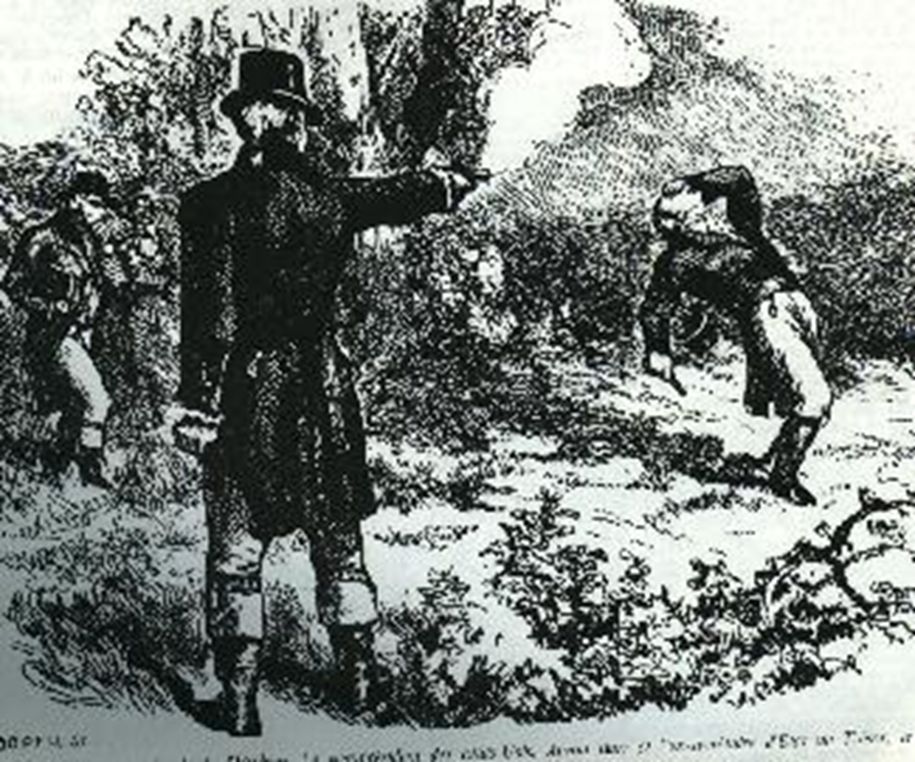
The Duel at Weehawken, NJ
Burr shot Hamilton and killed him.
Wanted for murder, he fled to Louisiana Territory, rumors of treason and an attempt to create new government.
Eventually acquitted, in part by Chief Justice Marshall’s influence

Slide 20
War of 1812
Problems between Britain and France caused dilemma for American merchant ships.
Westward expansion upset natives, caused them to forge allies with British in Canada and Spanish in Florida.
Impressment:
  British navy impressed, or forced, sailors to stay and fight on their ships if they deserted.
  Many of these deserters often joined American ships, so British began impressing American sailors on merchant ships.
  Ex: The Chesapeake – Leopard Incident

Slide 21
Controversial Embargo Act
Passed to prevent future incidents like the Chesapeake – Leopard.
Forbade American ships from leaving any U.S. port for any foreign port, anywhere in the world.
The law induced a depression in the American economy, Northeastern merchants (mostly Federalists) were completely cut off and lost money.
Madison, Jefferson’s successor, barely won election of 1808 as a result and Jefferson approved bill recalling the Embargo Act days before leaving office.

Slide 22
Indian Problems
Jefferson appointed William Henry Harrison as governor of the Indiana Territory.
He told natives to either assimilate to American society or move west of Mississippi River.
  Harrison’s nasty tactics to enforce the law upset tribes.
  After the Chesapeake – Leopard Incident, the British in Canada feared American retaliation, began supporting natives in the Indiana Territory.
The Prophet and his brother Tecumseh were first to organize multiple native groups in response to America.

Slide 23
Battle of Tippecanoe
While Tecumseh was away, Harrison invoked a fight along Tippecanoe Creek
  Hotly contested, but effectively drove off The Profit
  When Tecumseh returned his warrior were greatly upset and raided American settlement from Michigan to Mississippi.
Problems with Spanish settlements also created concern.
  Escaped slaves often found refuge there and would join in fight against U.S. settlements.
Feeling in Congress that war with Britain would allow them to also claim Spanish territory to the South.

Slide 24
Early Battles of War
Predominantly naval victories
  U.S. gained control of Lake Eerie through Oliver Hazard Perry’s victory at Put-In-Bay
Harrison sailed up Thames River and won notable battle where Tecumseh was killed
  Served to soften native support for the British in Canada.
Andrew Jackson makes a name for himself fighting the indians near Florida.
  Brutal tactics, killing women and children, force the Creeks to surrender as he moved further into Fla.

Slide 25
British Invasion
Following Napoleon’s surrender the British focused on invasion of America.
  Easily made their way to Washington and burned the White House in retaliation for U.S burning Toronto.
Battle at Fort McHenry was for control of Baltimore,
    Francis Scott Key, Washington lawyer, writes the Star Spangled Banner.

Slide 26
Northern Opposition to the War
Accept Battles of Put-in-Bay, McHenry, and New Orleans, most military operations were mishandled and embarrassing.
Northern Federalist strongly opposed war and even celebrated losses.
Hartford Convention: New England Federalists once again met to discuss secession
  Soon followed by News of Jackson’s victory at New Orleans and Peace treaty.
  Newfound Patriotism caused ideas to fizzle out and virtually ended the Federalist party as a whole.

Slide 27
Treaty of Ghent
Signed on Christmas Eve 1814
Basically Britain was tired from fighting Napoleon and wanted to be done, so they gave concessions.
Americans realized two things:
  Now that Napoleonic wars were done impressment was no longer an issue
  Canada cession to the U.S. was not going to happen.

Slide 28
Battle of New Orleans
Actually took place 2 weeks after Treaty of Ghent.
Jackson and ragged group of Tennesseans, Kentuckians, Creoles, blacks, pirates, and soldiers vs. battle hardened British from Napoleonic wars.
700 dead British, 1,400 wounded, 500 prisoners, and commander dead.
  British exposed and Jackson under great cover, eventually forced them to retreat.
Jackson lost 8 soldiers and 13 were wounded.
Win will eventually lead Jackson into the White House.

